Slide 1

CO2 Emissions & its relationship with GDP and Population
BY: ARUSHI GUPTA, UMID 30582819

Slide 2
AIM OF PROJECT
Find out what has been the trend in carbon dioxide emissions from cement production and other fossil fuel combustion worldwide.
Datasets of CO2 emissions, GDP and Population from year 1960 to year 2014 have been taken from:
Find out the relationship of CO2 emissions to GDP and population.
Find out which countries has the highest contribution to CO2 emissions.
Compare different regression tools (linear regression, decision tree and random forest regression) to get the predicted values and accuracy score of the regression technique.
https://data.worldbank.org/indicator/en.atm.co2e.kt
https://data.worldbank.org/indicator/ny.gdp.mktp.cd
https://data.worldbank.org/indicator/SP.POP.TOTL?view=chart

Slide 3
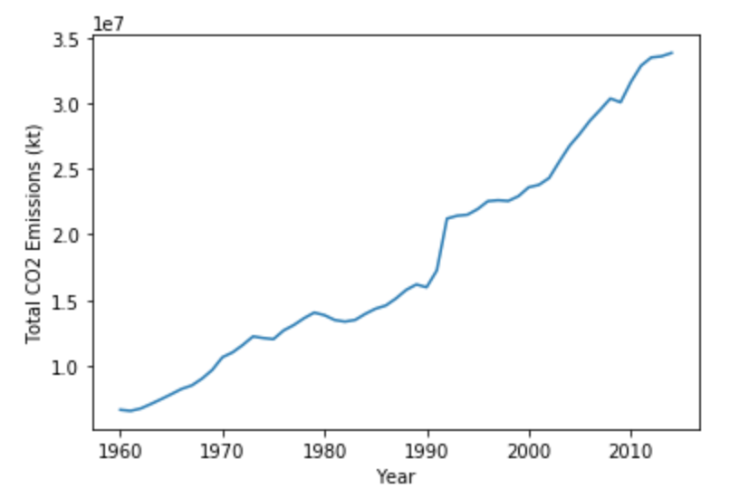
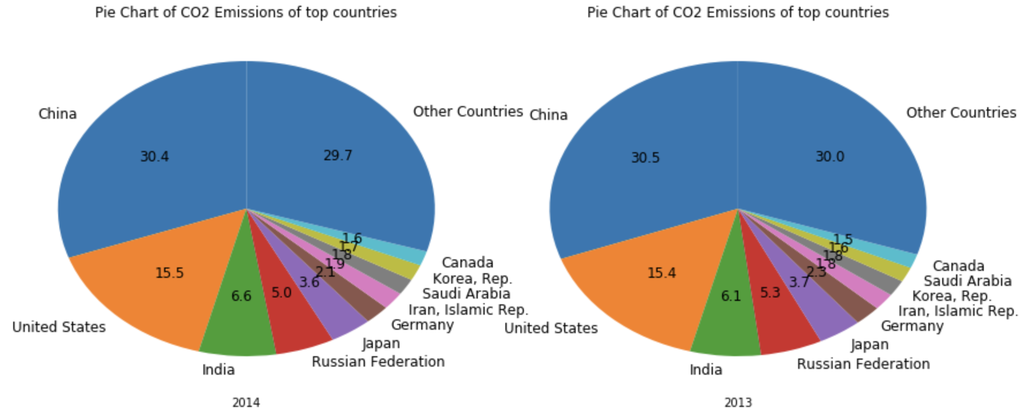
Global CO2 Emissions FROM CEMENT PRODUCTION AND FOSSIL FUEL COMBUSTION
There is dramatic increase in CO2 emissions from 6.6 KT in 1960 to 33.8 KT in 2014.
Since 1990 there is drastic increase in CO2 emissions because of rapid development in China, where cement production has grown by a factor of more than 11, such that 75 % of global growth in cement production since 1990 occurred in china. ⁽¹⁾
https://www.earth-syst-sci-data.net/10/2213/2018/essd-10-2213-2018.pd
f
SHARE OF COUNTRIES IN CO2 EMISSIONS

Slide 4
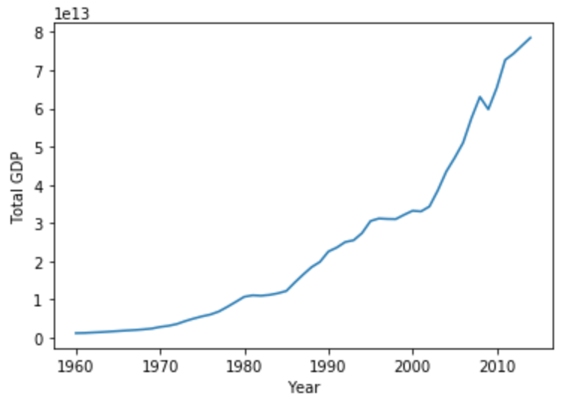
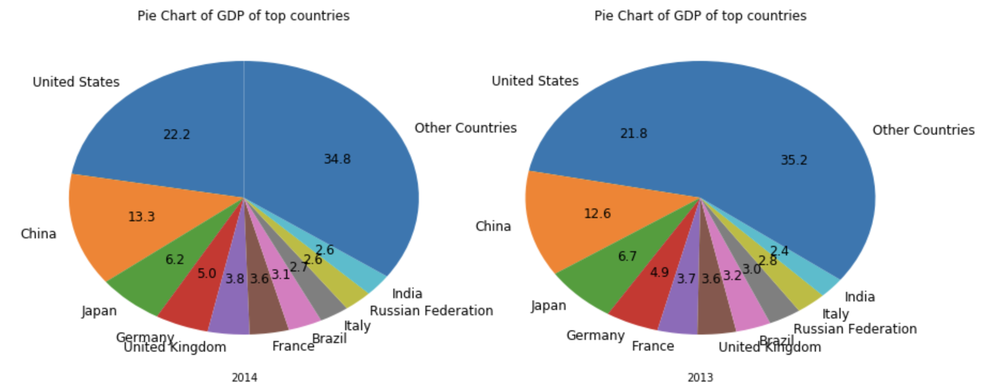
Gross Domestic Production Worldwide
World GDP has increased from 1.16 trillions in year 1960 to more than 78 trillions in year 2014.
Dramatic increase in GDP has been seen in year 2004, from 38.5 trillions in year 2003 to 43.4 trillions in year 2004, due to increased economic growth contributed mainly by China and India.
World GDP has increased consistently barring year 2008 because of financial crisis since Great Recession that resulted in dip in the worldwide economy.
SHARE OF COUNTRIES IN WORLD GDP

Slide 5
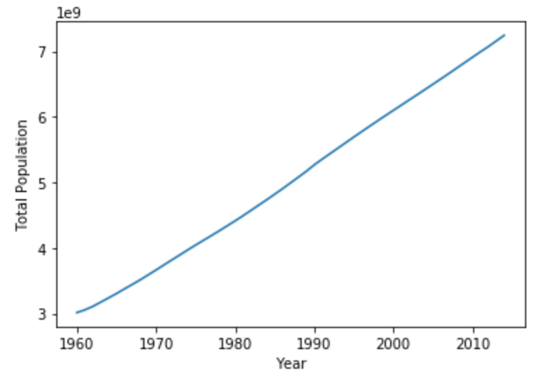
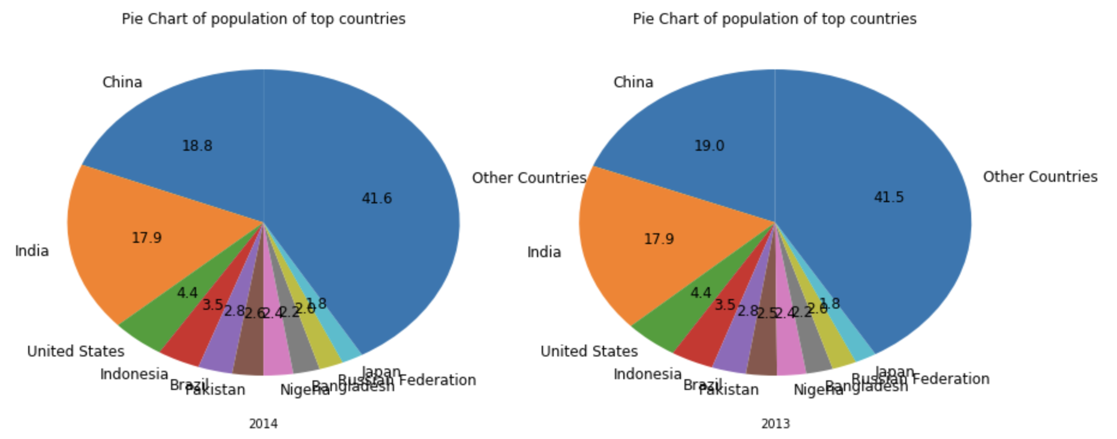
Population Growth WORLWIDE
There has been relentless increase in the World population from 3.04 billions in 1960 to 7.24 billions in 2014.
Almost consistent increase in Population has been seen with major contributions by China and India.
SHARE OF COUNTRIES IN WORLD POPULATION

Slide 6
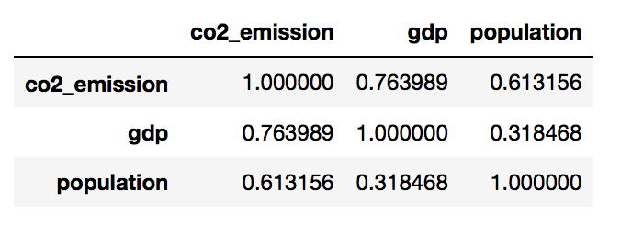



CO2 Emissions AND ITS RELATION WITH GDP & POPULATION using Regression
Correlation Matrix shows that both GDP and Population are correlated to CO2 Emissions.
Linear Regression gives a test accuracy of 78%.
Decision Tree Regression improved accuracy to 81%.
Random Forest Regressor further improved accuracy to 87% which again shows that CO2 Emissions can be predicted for given GDP and Population with reasonable accuracy.

Slide 7
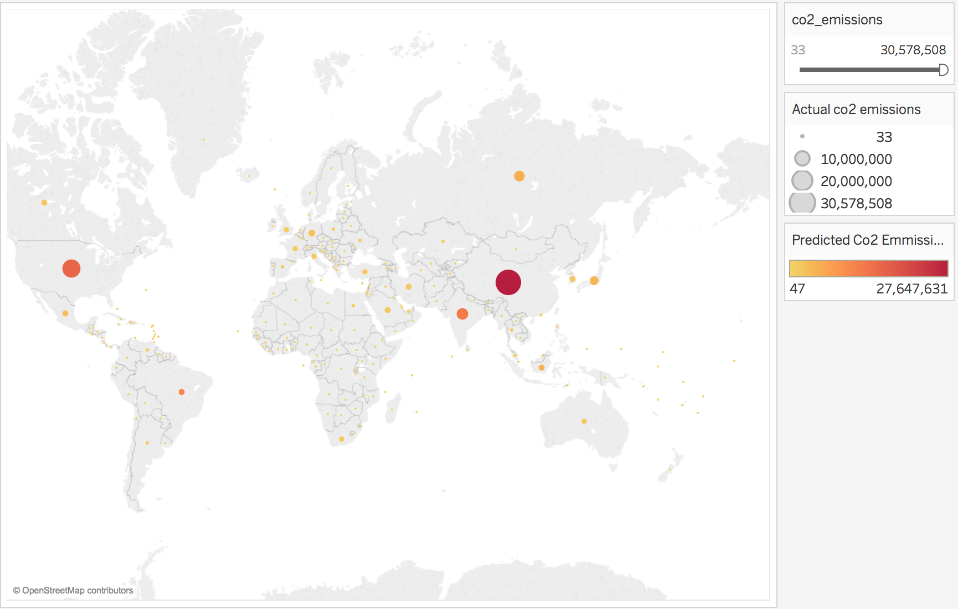
CO2 Emissions predictions using Regression in TABLEAU
Higher sized bubbles are darker showing that the actual and predicted CO2 emission values match for year 2012.

Slide 8
Conclusions
CO2 Emissions have shown relationship with GDP & Population. With economic growth and increase in population, CO2 emissions have also grown at much higher pace.
Effectiveness of existing policies in reducing the carbon footprint should be evaluated and new policies can be suggested.
Countries especially those with high GDP, income and population need to announce more-ambitious climate plans. And besides this it is very important to implement them and take help of people by spreading awareness among them before it gets too late.

